Slide 1
COMP 7212: Operating/Distributed Systems
Chapter 4: Communication
Dr. Myounggyu Won
“Inter-process communication is at the heart of all distributed systems.”
Reference: Distributed Systems: Principles and Paradigms (3rd Edition)

Slide 2
Outline
Foundations
  Layered protocols
  Types of communication
    Two widely used communication methods
Remote Procedure Call
  Basic operation
  Parameter passing
  RPC-based application support
  Validations on RPC
Message-oriented Communication
  Simple transient messaging with sockets
  Advanced transient messaging
  Message-oriented persistent communication
Multicast Communication
  Application-level tree-based multicast
  Flooding-based multicasting
  Gossip-based data dissemination

Slide 3
Foundations
“Let’s first recap some of the fundamental issues related to communication.”

Slide 4
Layered Protocols (1/3)
The inter-process communication in distributed systems is mostly based on sending and receiving messages
Sender P and receiver Q should agree on how a message is transmitted and interpreted (i.e., protocols)
Communication protocols form the basis for any distributed system.
Typically, layers of protocols are used.
  e.g., the OSI (Open Systems Interconnection) reference model
    Seven layers, each providing communication service
    Each layer provides an interface to the one above it
      This way, the problem of getting a message from P to Q can be divided into manageable pieces.

Slide 5
Layered Protocols (2/3)
The OSI model
  Physical layer: standardizes how two computers communicate at the physical level
  Data link layer: provides services related to error detection/correction and access control (e.g., two or more devices are connected to the same communication medium)
  Network layer: defines how a message is routed over multiple nodes
  Transport layer: provides services related to connection management and reliable delivery
  Session layer: provides support for managing and controlling the interactions between applications.
  Presentation layer: prescribes how data are represented
  Application layer: defines protocols specific for different applications, e.g., e-mail protocols, file-transfer protocols, etc.

Slide 6
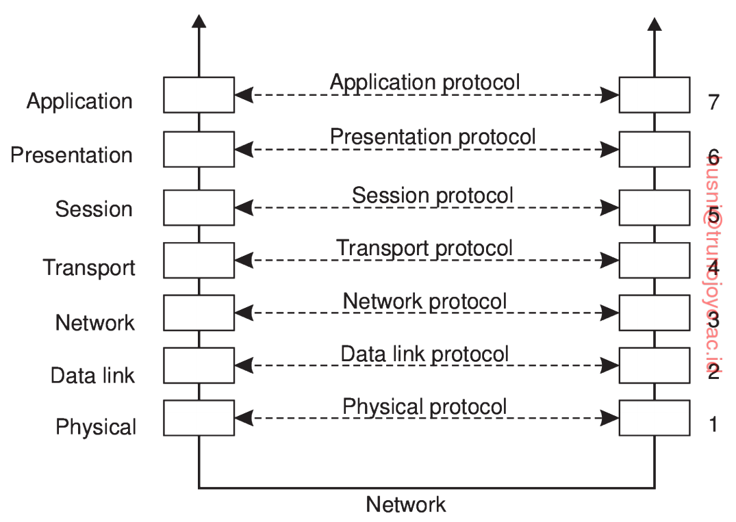

Slide 7
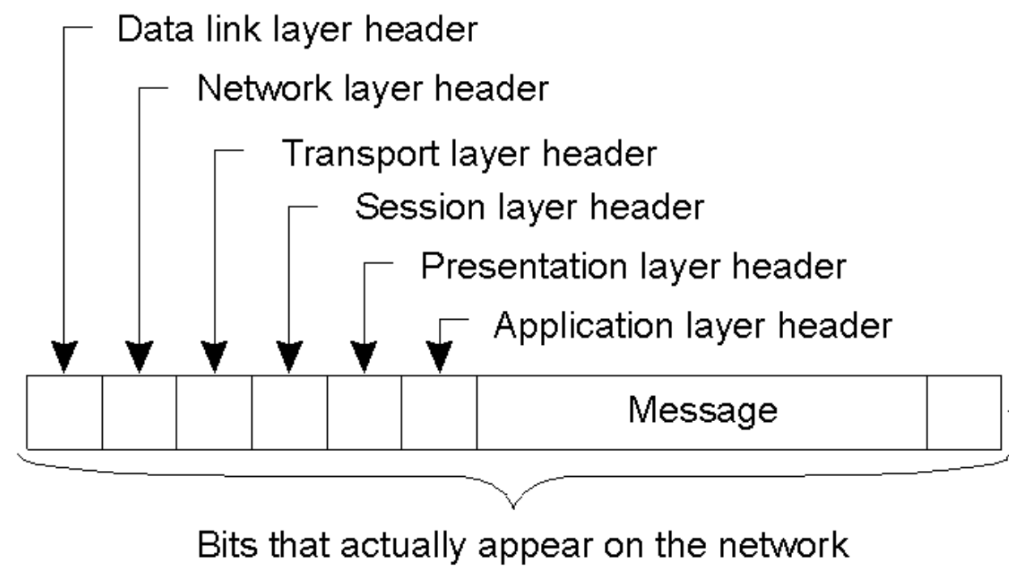
When data moves from the application layer down to the physical layer for transmission, each layer adds its header to the data from the upper layer.

Slide 8
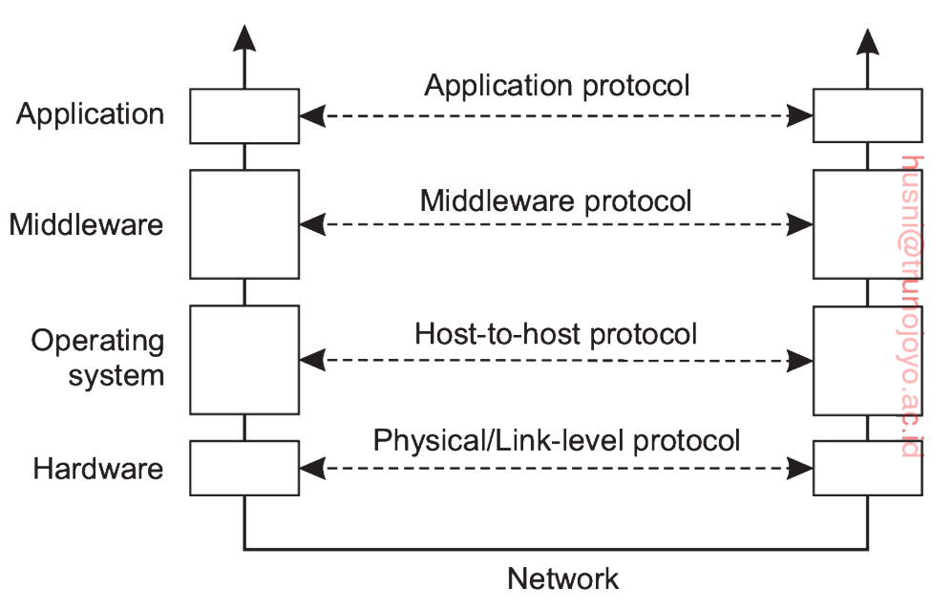
Layered Protocols (3/3)
Adapted reference model
  A simplified conceptual model for the four layered distributed systems
  The session and presentation layer are replaced by a middleware layer.
    Hide data representation and access methods
  The network and transport layers are grouped into communication services of OS (OS layer)
    Handles message forwarding
  The data link and physical layers are grouped into the physical/link-level protocol (hardware layer)

Slide 9
Types of Communication (1/2)
Persistent communication
  A message that has been submitted for transmission is stored by the communication middleware as long as it takes to deliver it to the receiver, regardless whether the sending and receiving applications are executing
  Examples: E-mail services, social media platforms, Google docs
Transient communication
  A message is stored only as long as the sending and receiving applications are executing
  Examples: real-time apps, streaming apps

Slide 10
Types of Communication (2/2)
Asynchronous communication
  A sender continues immediately after it has submitted its message for transmission
Synchronous communication
  A sender is blocked until its request is known to be accepted
  Three points when the sender is released:
    Until the middleware acknowledges reception of the request
    Until the request has been sent to the receiver
    Until the response is received from the receiver

Slide 11
Remote Procedure Call
“We will discuss the concept, implementation, strengths, and weaknesses of the
remote procedure call method”.

Slide 12
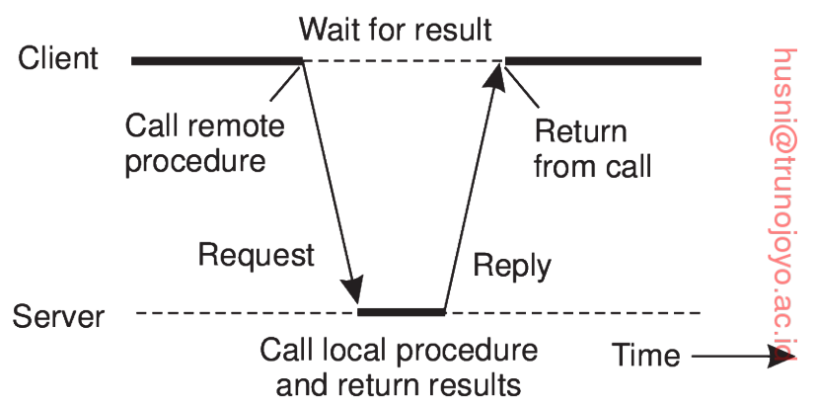
Basic RPC Operation (1/3)
It allows programs to call procedures located on remote machines.
The goal is to make a remote procedure call look as much as like a local call
  Distribution transparency – a calling procedure does not know the called procedure is executing on a different machine
To achieve distribution transparency, a client stub is used
  It packs the parameters in a message to be sent to the server.

Slide 13
Basic RPC Operation (2/3)
  When the message arrives at the server, the server’s operating system passes it to a server stub
    Transforms requests coming in over the network into local procedure calls with unpacked parameters
    After a procedure execution is completed, the result is packed in a message and returned to the client
  The client stub inspects the message, unpacks the result, copies it to its caller, and returns
  All the details on the message exchanges are not exposed to users.

Slide 14
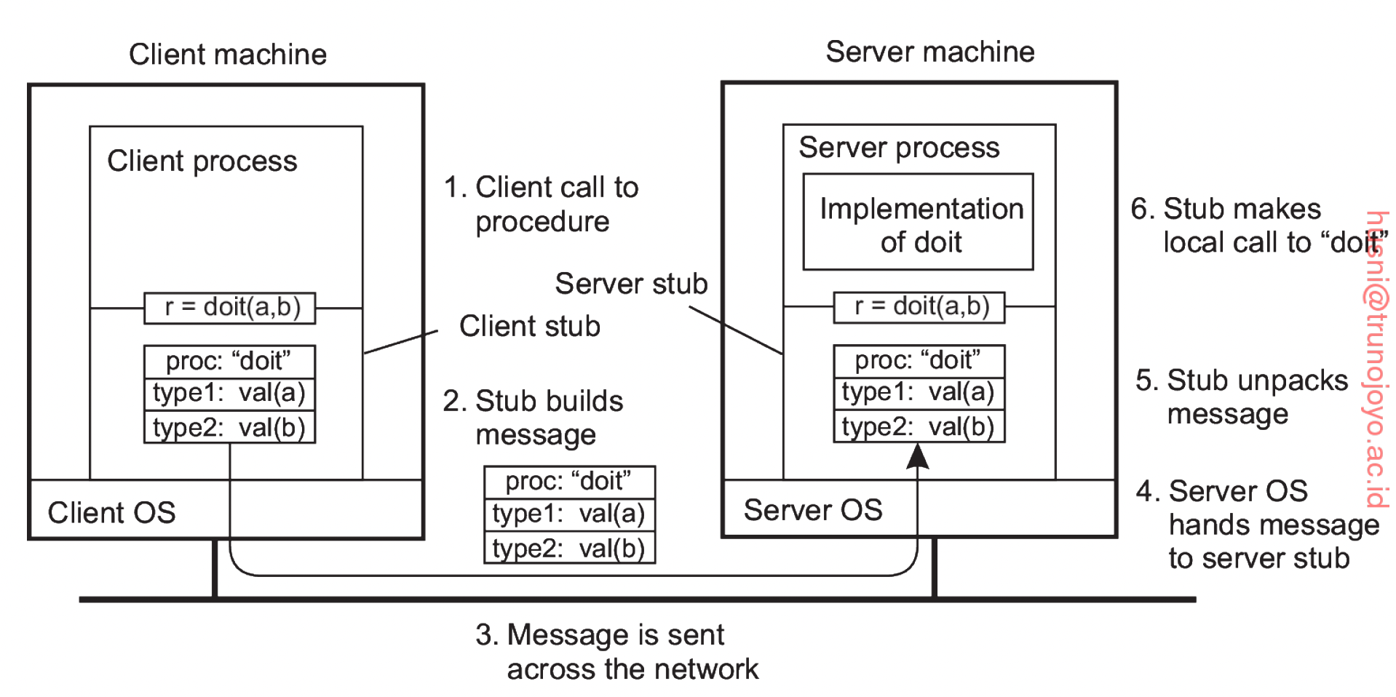
Basic RPC Operation (3/3)

Slide 15
Parameter Passing (1/2)
Packing parameters into a message is called parameter marshaling
Two challenges
  How does the server recognize the meta-information in a message?
    e.g., which part of incoming bits are function name and parameters
  How do we ensure correct information transfer between machines with different architectures (e.g., Intel vs ARM)
    Little endian vs big endian
      Two different ways of storing multibyte data-types.
      Little endian machines (Intel) – the last byte of the multibyte data-type is stored first in memory.
      Big endian machines (ARM) – the first byte of the multibyte data-type is stored first in memory.

Slide 16
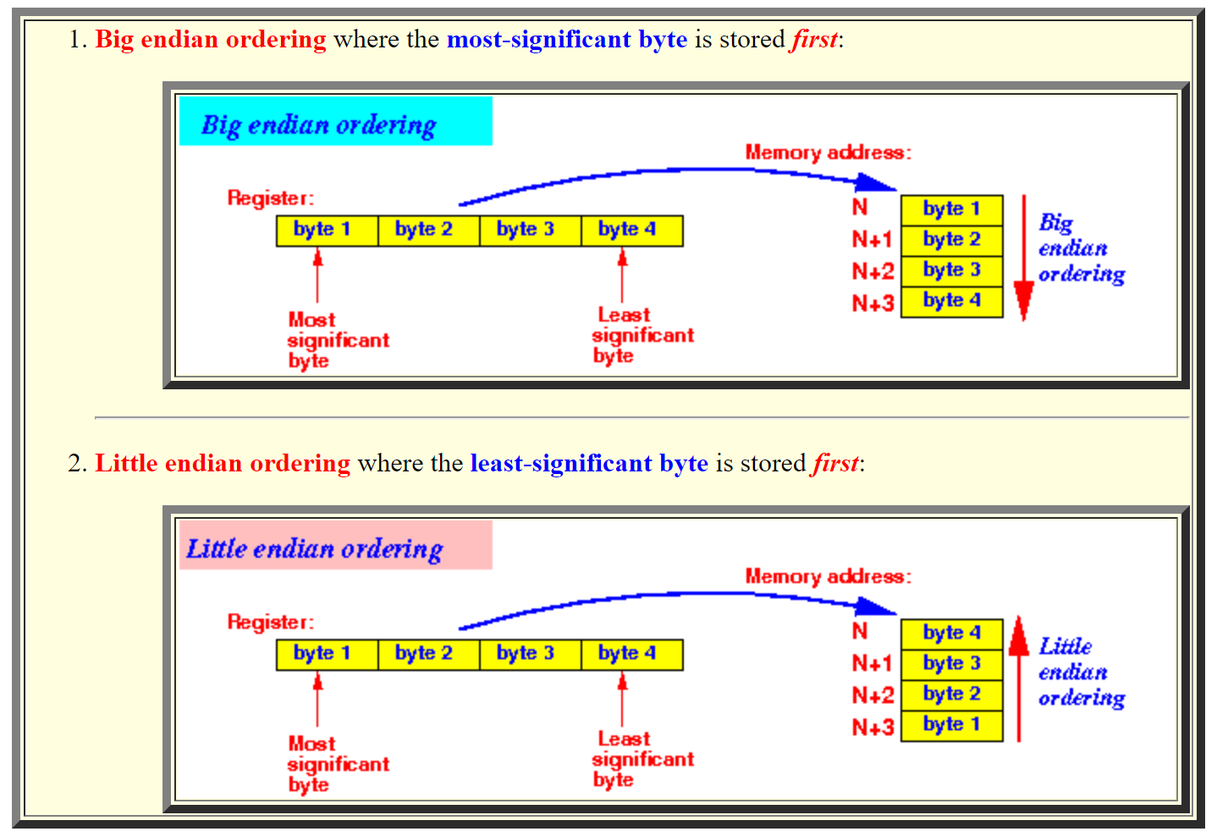
with the remaining bytes stored in the decreasing order of significance
with the remaining bytes stored in the increasing order of significance
© emory.edu

Slide 17
Parameter Passing (2/2)
A solution is to transform data into a machine- and network-independent format.
  This is what marshaling is designed for, i.e., it makes sure that bytes in the message are stored in a predefined order (Discussed more in the later slide) that both the client and server agree.
How about pointers?
  A pointer that refers to memory location in the local address space may point to something completely different on other machines!
  Pass a copy of the entire data structure
    This is easy but incurs overhead.
  Use a global reference
    Requires proper programming language support.
    Example: Microsoft COM (Component Object Model) uses globally unique identifiers for classes to ensure that objects created in one part of a distributed system can be precisely identified and referenced in other parts.

Slide 18
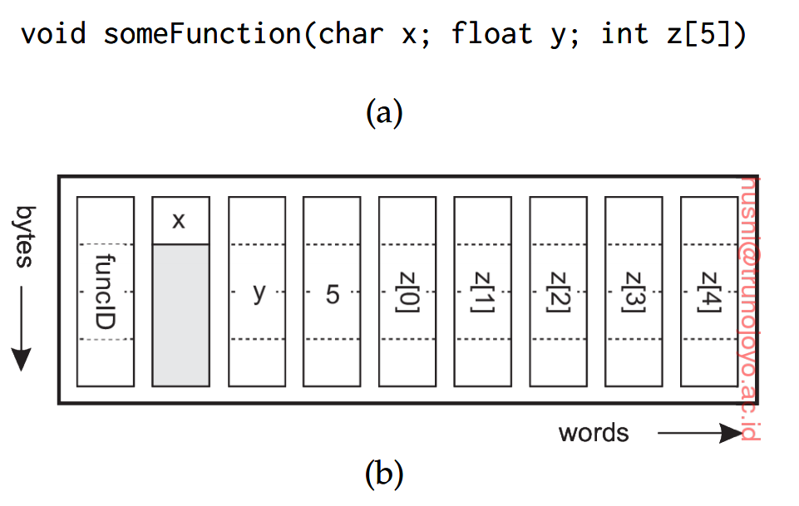
RPC-based Application Support (1/2)
How do we make both the client and server follow the same protocol (e.g., same message format) for RPC?
Approach 1: Ask the developer to specify exactly in a message what need to be called remotely
  Often specified by the means of an interface definition language (IDL)
  IDL provides a language-neutral way to describe data types and structures that are passed between clients and servers
  Examples: CORBA (Common Object Request Broker Architecture), Microsoft COM/DCOM (Component Object Model / Distributed Component Object Model)

Slide 19

RPC-based Application Support (2/2)
Approach 2: Embed remote procedure calling as part of a programming-language environment (let the programming language do the job)
  Application development becomes much simpler.
  e.g., JAVA’s remote method invocation (RMI), Google’s gRPC (supports various programming languages), Python’s Pyro, Erlang’s Erlang Distribution, …

Slide 20
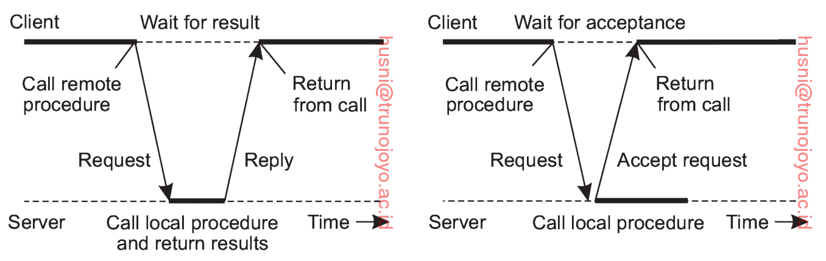
Variants of RPC (1/4)
Several variations on RPC in terms of whether a client is blocked when a remote procedure call is made
Asynchronous RPC
  The server immediately sends a reply.
  The client continues without being blocked.
  Useful when there is no result to return.
Traditional RPC
Asynchronous RPC

Slide 21
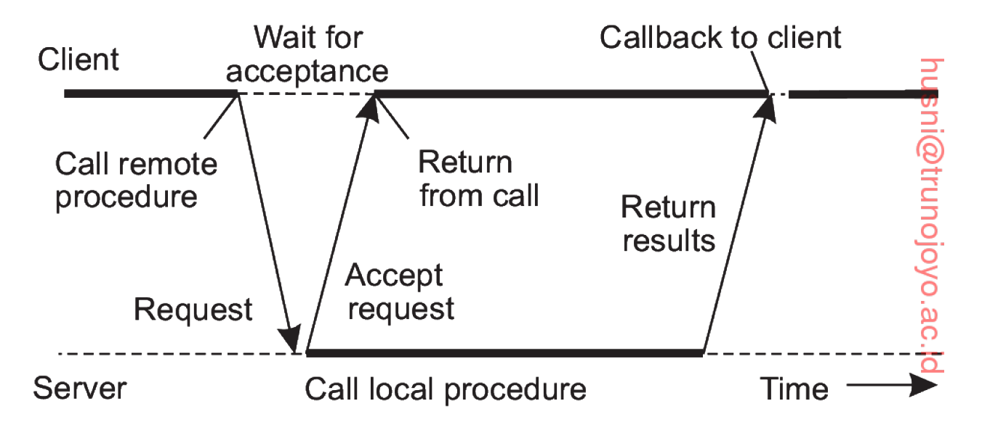
Variants of RPC (2/4)
Deferred synchronous RPC
  Asynchronous RPC combined with a callback
  A callback is a user-defined function that is invoked when a special event happens
  When results become available, the server sends a response message that leads to a callback at the client

Slide 22
Variants of RPC (3/4)
One-way RPC
  The client continues executing immediately after sending the request to the server and does not wait for an acknowledgement of the server’s acceptance
  The reliability is not guaranteed
  Why use One-way RPC?
    Performance improvement (the client does not wait at all, and the server does not need to respond to each RPC call)
      -> Higher scalability
    Minimizes the latency (particularly useful in real-time systems)
    E.g., status update (losing one or two requests does not impact the performance)

Slide 23
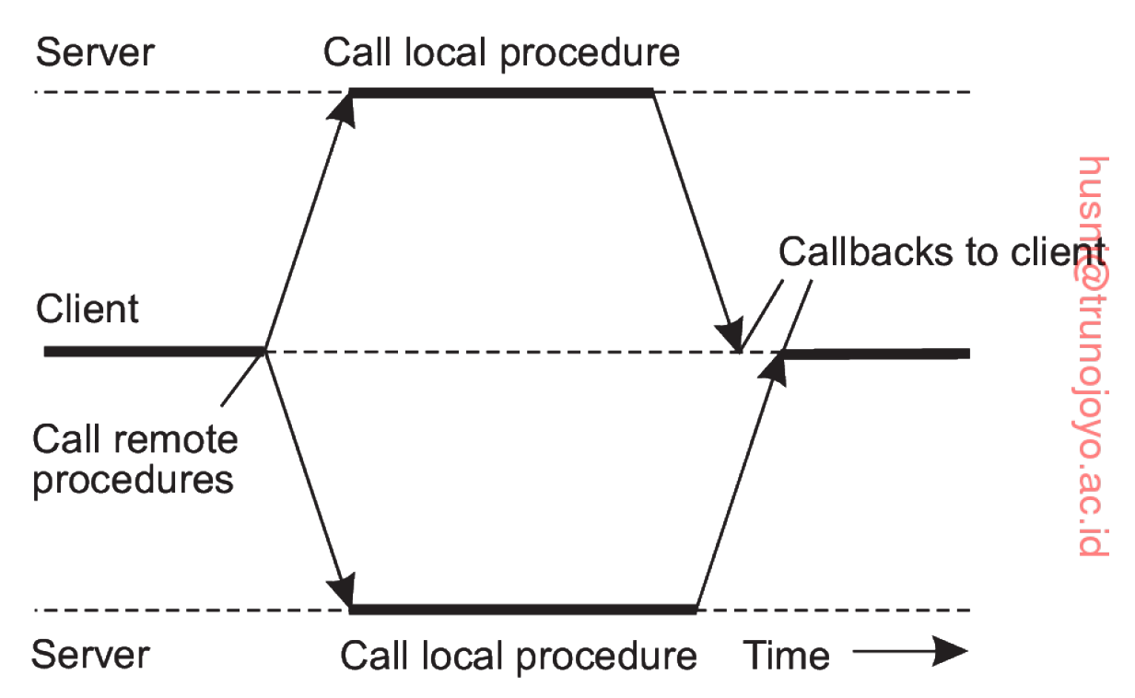
Variants of RPC (4/4)
Multicast RPC
  Executes multiple RPCs at the same time, i.e., sending an RPC request to multiple servers
  The client is unaware of the fact that an RPC request is actually being forwarded to more than one server
  Issues
    Decide what to do with responses, e.g., proceed if all responses are received, or wait just for one.

Slide 24
Message-Oriented Communication
“A different communication service is needed to address the synchronous nature of RPCs
and the limitation of RPCs that the client and server must be executing at the time of
communication.”

Slide 25
Limitations of RPC
The receiving side should be executing when a request is issued.
  Supports only the transient communication
The client is blocked (although it can perform another task while waiting for a reply) until its request has been processed.
Message-oriented communication addresses these limitations.
  Supports both the persistent and transient communication

Slide 26
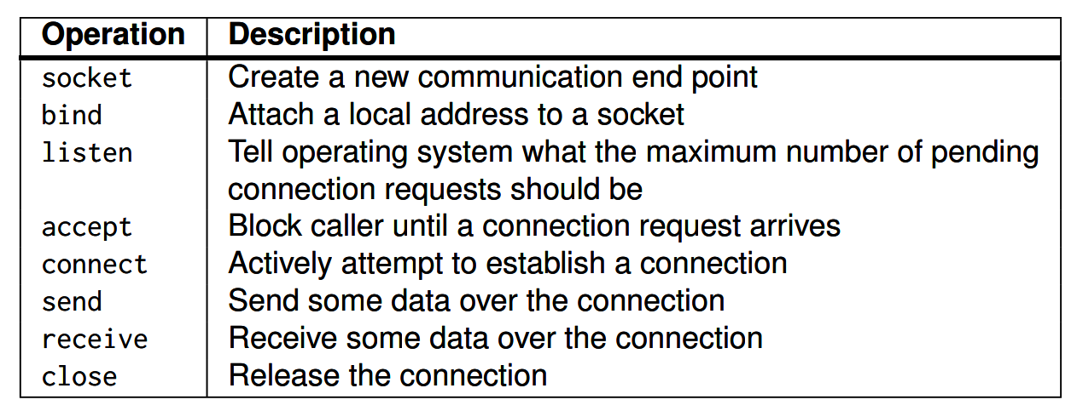
Simple Transient Messaging with Sockets (1/2)
Socket interface
  A socket is a communication end point to which an application writes data, and from which incoming data can be read.
  Socket operations for TCP/IP

Slide 27
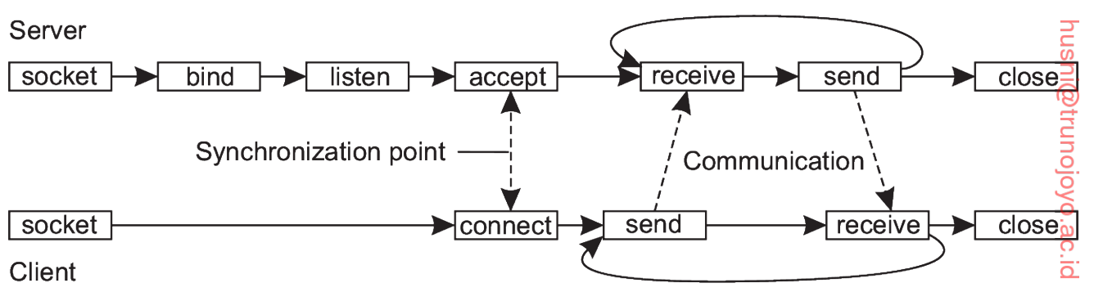
Simple Transient Messaging with Sockets (2/2)
Connection-oriented communication pattern using socket

Slide 28
Advanced Transient Messaging (1/6)
The standard socket approach is very basic
  Any extra facility (e.g., message formatting, error checking, buffering, resource management, etc.) for messaging needs to be implemented by the programmer.
We often need more advanced approaches, e.g., to better use resources, to make network programming easier, and to expand beyond functionality offered by existing socket interface.

Slide 29

Advanced Transient Messaging (2/6)
ZeroMQ socket
  Setting up and maintaining connections is kept under the hood
    An application programmer does not need to bother with setting up connections (i.e., listen and accept)
  A server can listen to multiple ports using a single blocking call.
  ZeroMQ sockets support asynchronous communication
    A sender continues after having submitted a message to the underlying communication system.
  ZeroMQ sockets support various kinds of communication patterns.

Slide 30
Advanced Transient Messaging (3/6)
To make network programming easier, many messaging applications (or components) can be organized according to a few simple communication patterns
Three most important communication patterns supported by ZeroMQ sockets
  Request-reply pattern: used in traditional client-server communication
    A client uses a request socket to send a request message.
    A server uses a reply socket
    Simplifies matters for developers by avoiding the need to call the listen operation as well as the accept operation
      These operations are done automatically with a single bind() call.

Slide 31
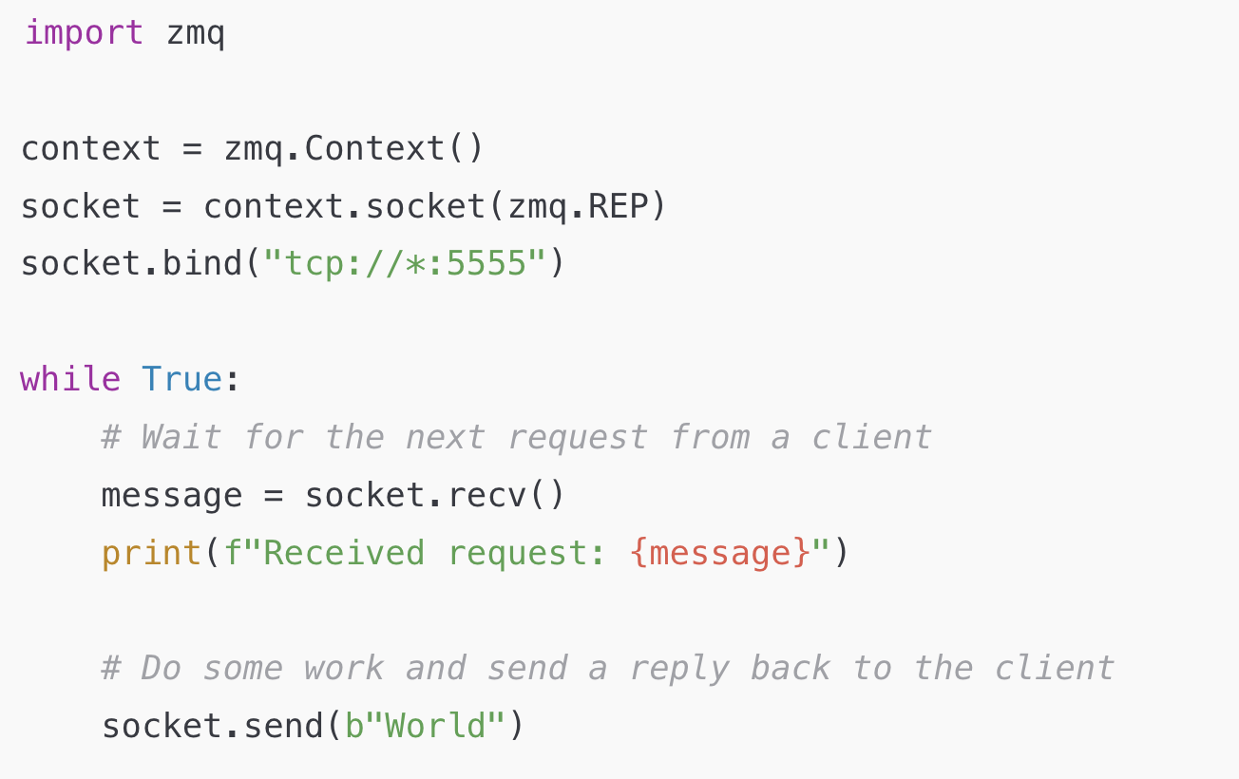
Example Python Server Code
// zmq object creation
// zmq socket creation
// REP: server-side in the request-reply
// pattern
Connection received via any local network interface

Slide 32
Advanced Transient Messaging (4/6)
Three most important communication patterns supported by ZeroMQ sockets (cont.)
  Publish-subscribe pattern
    A client subscribes to specific messages that are published by servers
    Only the messages to which the client has subscribed will be transmitted
    Messages from the server that no one has subscribed will be dropped

Slide 33
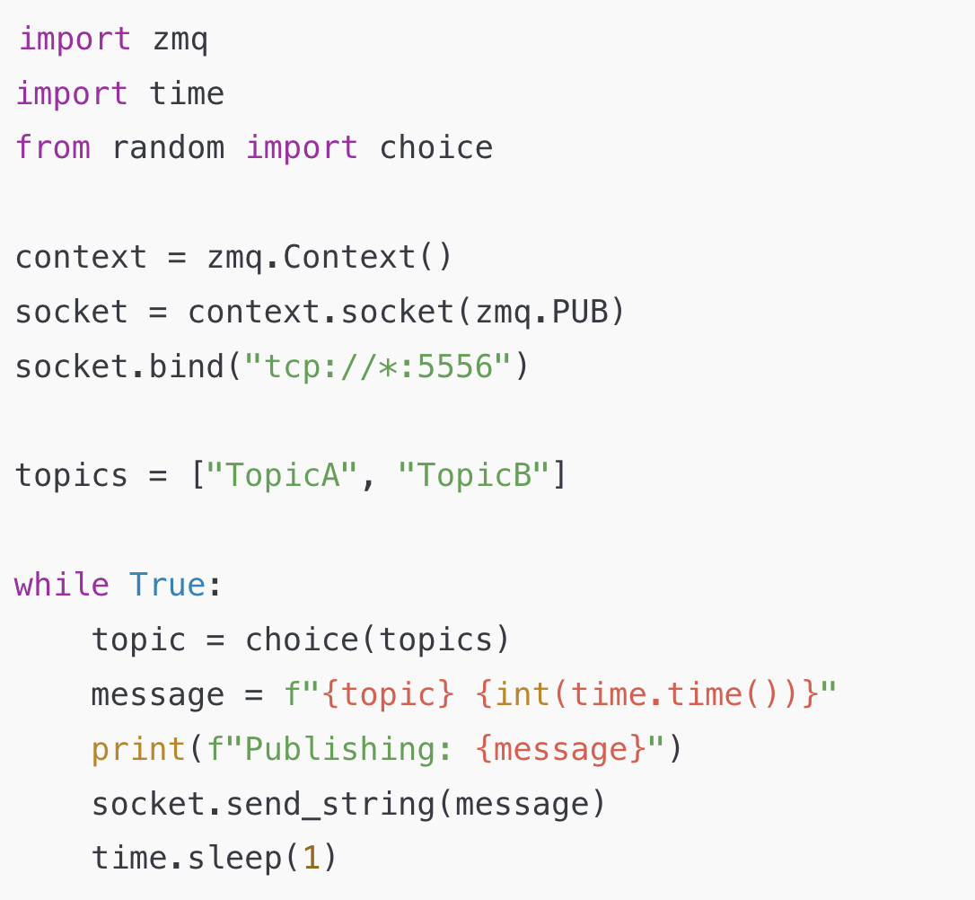
Example Python Code

Slide 34
Advanced Transient Messaging (5/6)
Three most important communication patterns supported by ZeroMQ sockets (cont.)
  Pipeline pattern
    The pipeline pattern is designed for distributing tasks across multiple workers.
      Note that the goal of the publish and subscribe pattern is to distribute information (all subscribers receive the same information)
      On the other hand, for the pipeline pattern, the goal is to distribute work (different tasks)
    It is used primarily for load balancing and parallel processing.

Slide 35
Advanced Transient Messaging (6/6)
Message Passing Interface (MPI)
  Sockets alone provide only a basic communication mechanism for high-performance distributed systems.
    Support only low-level, point-to-point send and receive operations.
    Parallel applications often require higher-level communication support (multi-to-multi communication)
      Efficient buffering
      Synchronization among processes
  MPI is designed for parallel applications
  MPI assumes communication takes place within a known group of processes
  Instead of transport-level addresses (e.g., IP address for point-to-point communication), a unique identifier (groupID, processID) is used for communication (for easier implementation of synchronization and buffering)

Slide 36
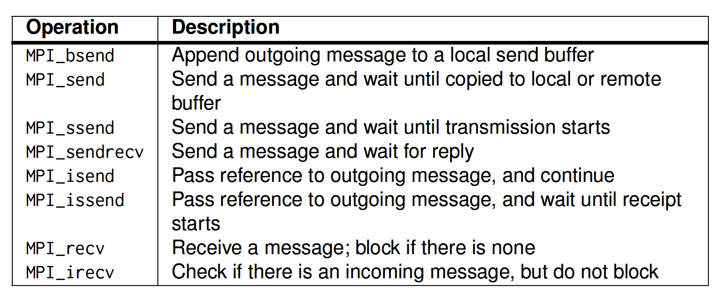
More about MPI
Messaging operations of MPI

Slide 37
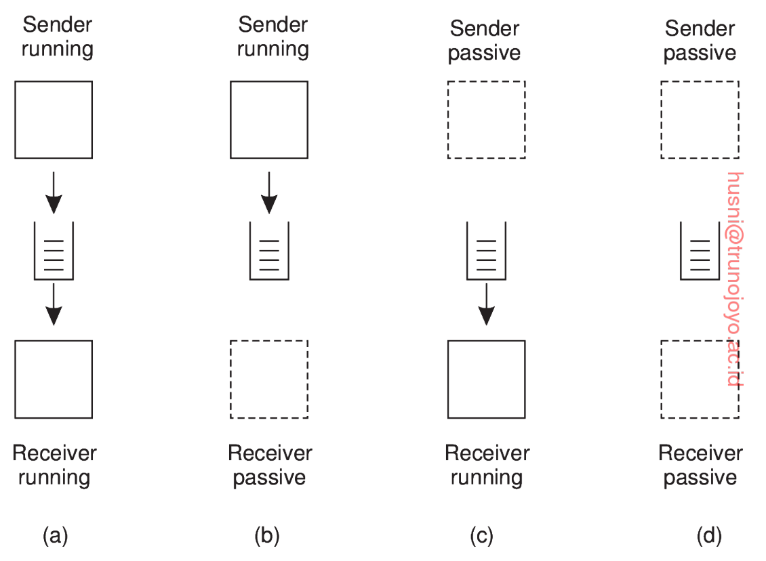
Message-Oriented Persistent Communication (1/6)
Message queuing systems provide intermediate-term storage capacity for messages, without requiring either the sender or receiver to be active during message transmission
Message-queuing model

Slide 38
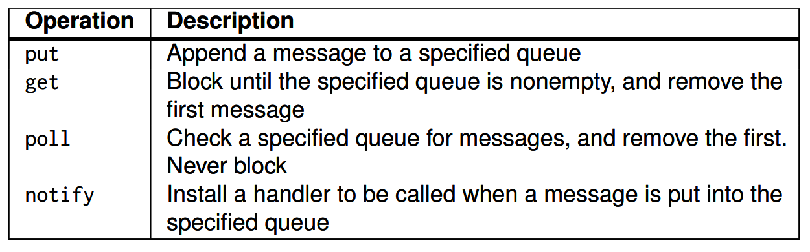
Message-Oriented Persistent Communication (2/6)
Basic interface to a queue in a message-queuing system

Slide 39
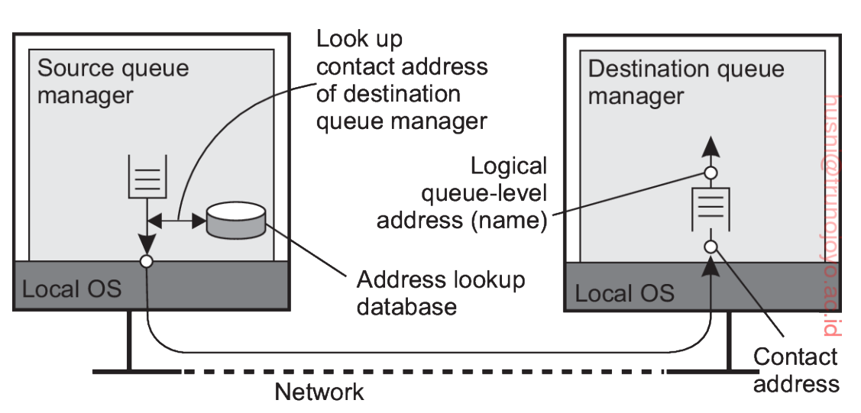
Message-Oriented Persistent Communication (3/6)
General architecture of a message-queuing system
  Queues are managed by queue managers (usually a separate process)
  An application can put messages only into a local queue
  Getting a message is possible by extracting it from a local queue only
Issues
  Since messages are put into only local queues, the message should carry information concerning the destination; How the destination queue is addressed?
    Contact address such as (host name, port) of destination queue manager
    Name-to-address mapping is available locally

Slide 40
Message-Oriented Persistent Communication (4/6)
Issues cont.
  How is the name-to-address mapping actually made available to a queue manager?
    Implement the mapping as a lookup table and copy that table to all managers (more details in Chapter 5)
      Leads to a maintenance problem (i.e., updating all tables when a change is made)
  How to efficiently maintain name-to-address mappings?
    Each queue manager needs to know the address of every other queue manager?
      Scalability issue
    There is often a special queue manager that operates as routers that forward messages to other queue mangers

Slide 41
Message-Oriented Persistent Communication (5/6)
More issues
  How to integrate new applications, i.e., how to make them understand messages they receive from different applications?
  A message broker acts as an application-level gateway in a message-queuing system
  Its main purpose is to convert incoming messages so that they can be understood by the destination application

Slide 42
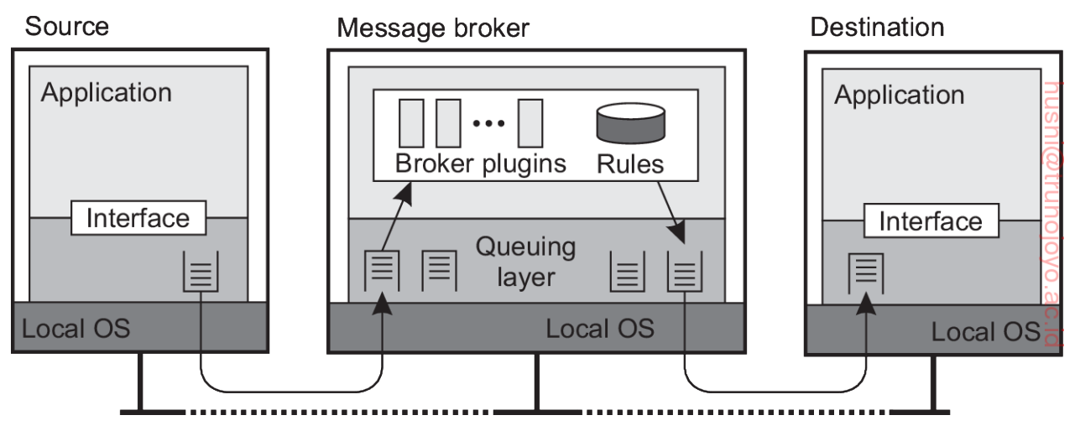
Message-Oriented Persistent Communication (6/6)
Message brokers cont.
  Maintaining a repository of rules for transforming messages of one type to another is the key function of a message broker
  Each plugin of the message broker performs conversion between two specific applications -> allows transmission of a message from App A to many different Apps

Slide 43
Multicast Communication
“An important topic in communication in distributed systems is the support for sending data to
multiple receivers.”

Slide 44
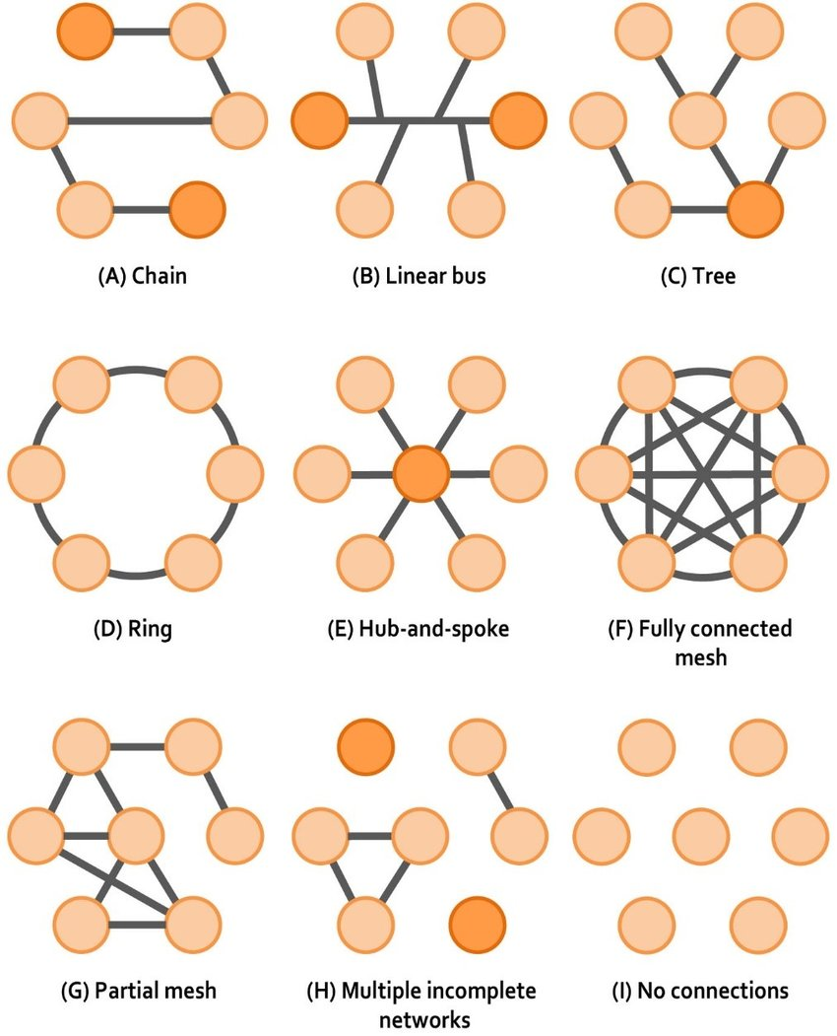
Tree-based Multicasting (1/2)
Nodes organize into an overlay network, which is used to disseminate information to its members
A crucial issue is the construction of the overlay network
  Nodes organize into a tree
  Nodes organize into a mesh network
    Mesh topology is a type of network topology in which each node is connected to as many other nodes as possible fully through dedicated link in the network.
    Provides higher robustness

Slide 45
Tree-based Multicasting (2/2)
Performance issues
  Building an efficient tree is a challenging problem.
  The quality of a multicast tree is measured by three different metrics
    The link stress defines how often a packet crosses the same link
    Stretch is the ratio between the delay experienced by two nodes when communicating through the overlay network and the minimum possible delay between those same two nodes.
    Tree cost is the sum of the costs of all links used in the dissemination tree.

Slide 46
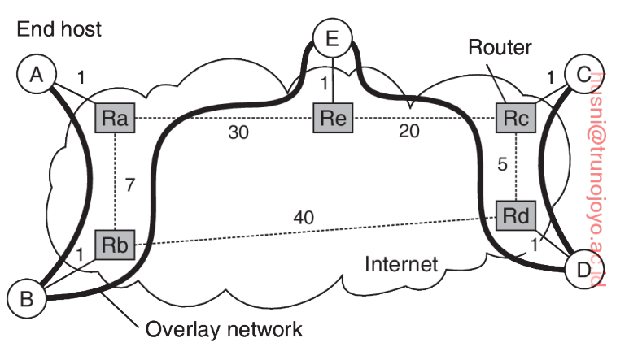
Links with link stress > 1

Slide 47
Stretch between B and C = 73/47 = 1.55

Slide 48
Flooding-based Multicasting (1/2)
A key design issue for multicasting is to minimize the use of intermediate nodes for which the message is not intended
To avoid this inefficiency, we can construct an overlay network per multicast group and broadcast message over the network (i.e., flooding)
  A multicast group is a set of receivers interested in receiving a particular set of data traffic.

Slide 49
Flooding-based Multicasting (2/2)
To reduce the number of messages, we can also use probabilistic flooding
  Regular flooding can lead to multiple reception of the same message.
  A node forwards a message with a certain probability
  Probabilistic flooding is particularly useful in scenarios where network resources are limited, such as in sensor networks or mobile ad hoc networks (MANETs)

Slide 50
Gossip-based Data Dissemination (1/3)
The main goal is to rapidly disseminate information among a large number of nodes using only local information (i.e., no central component which coordinates dissemination)
Three approaches for exchanging updates
  P only pushes its own updates to randomly selected Q (push-based)
    Not a good choice for rapidly spreading updates since only “infected” nodes propagate updates
    Some nodes will remain “not infected” for a long time since it is not selected by an infected node.
  P only pulls in new updates from Q (pull-based)
    Chances of getting infected is higher because nodes continually seek out new information until they receive it.
    Propagates data more slowly since a node only receives new data when it actively requests it from others.
  P and Q send updates to each other (push and pull-based)
    The best strategy

Slide 51
Gossip-based Data Dissemination (2/3)
Rumor spreading
  A variant of gossip-based protocols
  If P has been just updated, it contacts an arbitrary node Q and tries to push the update to Q
  It is possible that Q has been already updated
  In that case, P stops spreading update with probability p (it lost interests in spreading update)
    Avoid collision and reduce network congestion
  But it is not guaranteed that all nodes will be updated

Slide 52
Gossip-based Data Dissemination (3/3)
Directional gossiping
  Nodes that are connected to only a few other nodes are contacted with a relatively higher probability
    Those nodes are likely to be the one that forms a bridge to another network.
Removing data
  Epidemic (i.e., gossip-based) algorithms are extremely good for spreading updates
  However, spreading the deletion of a data item is hard because when a data item is removed from a node, that node may eventually receive an old copy of the data and interpret that as an update
  A solution is to record the deletion of data item and keep a record of that deletion
    This way, old copies will not be interpreted as an update

Slide 53
Exercise Question #1
Write a paragraph comparing push-based and pull-based gossip algorithms. Discuss the advantages and disadvantages of each method.

Slide 54
Exercise Question #2
Consider a network with nodes and edges as follows
  Nodes: A, B, C, D, E, F
  Edges with Weights:
    A-B: 4
    A-D: 1
    B-C: 1
    B-E: 5
    C-E: 1
    D-C: 2
    D-E: 8
    E-F: 1
Draw this network.
The shortest path from A to F is A → D → C → E → F. Calculate the path stretch for this path: A → D → E → F.

Slide 55
Exercise Question #3
Write a paragraph on the limitations and advantages of flooding in large-scale networks.

